Slide 1
Operating-System Structures
Operating System Services
User Operating System Interface
System Calls
Types of System Calls
System Programs
Operating System Design and Implementation
Operating System Structure
Virtual Machines
Operating System Generation
System Boot

Slide 2
Objectives
To describe the services an operating system provides to users, processes, and other systems
To discuss the various ways of structuring an operating system
To explain how operating systems are installed and customized and how they boot

Slide 3
Operating System Services
A set of operating-system services provides functions that are helpful to the user:
  User interface - Almost all operating systems have a user interface (UI)
    Varies between Command-Line (CLI), Graphics User Interface (GUI), Batch
  Program execution - The system must be able to load a program into memory and to run that program, end execution, either normally or abnormally (indicating error)
  I/O operations - A running program may require I/O, which may involve a file or an I/O device.
  File-system manipulation - The file system is of particular interest. Obviously, programs need to read and write files and directories, create and delete them, search them, list file Information, permission management.

Slide 4
Operating System Services (Cont.)
  Communications – Processes may exchange information, on the same computer or between computers over a network
    Communications may be via shared memory or through message passing (packets moved by the OS)
  Error detection – OS needs to be constantly aware of possible errors (Recovery, if possible, at least reporting)
    May occur in the CPU and memory hardware, in I/O devices, in user program
    For each type of error, OS should take the appropriate action to ensure correct and consistent computing
    Debugging facilities can greatly enhance the user’s and programmer’s abilities to efficiently use the system

Slide 5
Operating System Services (Cont.)
  Resource allocation - When multiple users or multiple jobs running concurrently, resources must be allocated to each of them
    Many types of resources - Some (such as CPU cycles, main memory, and file storage) may have special allocation code, others (such as I/O devices) may have general request and release code.
  Accounting - To keep track of which users use how much and what kinds of computer resources
  Protection and security - The owners of information stored in a multi-user or networked computer system may want to control use of that information, concurrent processes should not interfere with each other
    Protection involves ensuring that all access to system resources is controlled
    Security of the system from outsiders requires user authentication, extends to defending external I/O devices from invalid access attempts
    If a system is to be protected and secured, precautions must be instituted throughout it. A chain is only as strong as its weakest link.

Slide 6
User Operating System Interface - CLI
CLI allows direct command entry on Keyboard
  Sometimes implemented in kernel, sometimes by systems program
  Sometimes multiple flavors implemented – shells
  Primarily fetches a command from user and executes it
    Sometimes commands are built-in, sometimes just names of programs
      If programs, adding new features doesn’t require shell modification

Slide 7
Operating System Interface - GUI
User-friendly desktop metaphor interface
  Usually mouse, keyboard, and monitor
  Icons represent folders/files, programs, actions, etc
  Various mouse buttons over objects in the interface cause various actions (provide information, options, execute function, open directory (known as a folder)
  Invented at Xerox PARC (Palo Alto Research Center)
Many systems now include both CLI and GUI interfaces
  Microsoft Windows is GUI with CLI “cmd” command shell
  Apple Mac OS X as “Aqua” GUI interface with UNIX kernel underneath and shells available
  Solaris is CLI with optional GUI interfaces (Java Desktop, KDE)

Slide 8
System Calls
Programming interface to the services, provided by the OS in assembly language or other languages. Typically written in a high-level language (C or C++)
Mostly accessed by programs via a high-level APIs: Application Program Interface, rather than direct system calls
Some most common APIs are Win32 API for Windows, POSIX API for POSIX-based systems (including virtually all versions of UNIX, Linux, and Mac OS X), and Java API for the Java virtual machine (JVM)
Why use APIs, rather than system calls?
(Note that the system-call names used throughout this text are generic)

Slide 9

Example of System Calls
System call sequence to copy the contents of one file to another file

Slide 10

Example of Standard API
Consider the ReadFile() function in the
Win32 API—a function for reading from a file
A description of the parameters passed to ReadFile()
  HANDLE file—the file to be read
  LPVOID buffer—a buffer where the data will be read into and written from
  DWORD bytesToRead—the number of bytes to be read into the buffer
  LPDWORD bytesRead—the number of bytes read during the last read
  LPOVERLAPPED ovl—indicates if overlapped I/O is being used

Slide 11
System Call Implementation
Typically, a number is associated with each system call
  System-call interface maintains a table indexed according to these numbers
The system call interface invokes intended system call in OS kernel and returns status of the system call and any return values
The caller need not know about how the system call is implemented
  Just needs to obey API and understand what OS will do as a result call
  Most details of OS interface are hidden from programmer by API
    Managed by run-time support library (set of functions built into libraries included with compiler)

Slide 12
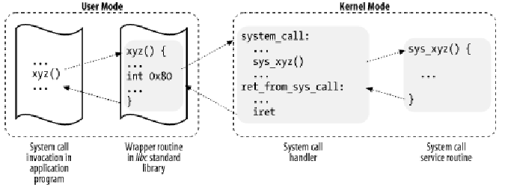
APIs or wrapper routines
The wrapper routines pass parameters to system call either through registers or pointer to process address space that contain parameter values. They also provide return values to caller and set errno.

Slide 13

API – System Call – OS Relationship

Slide 14
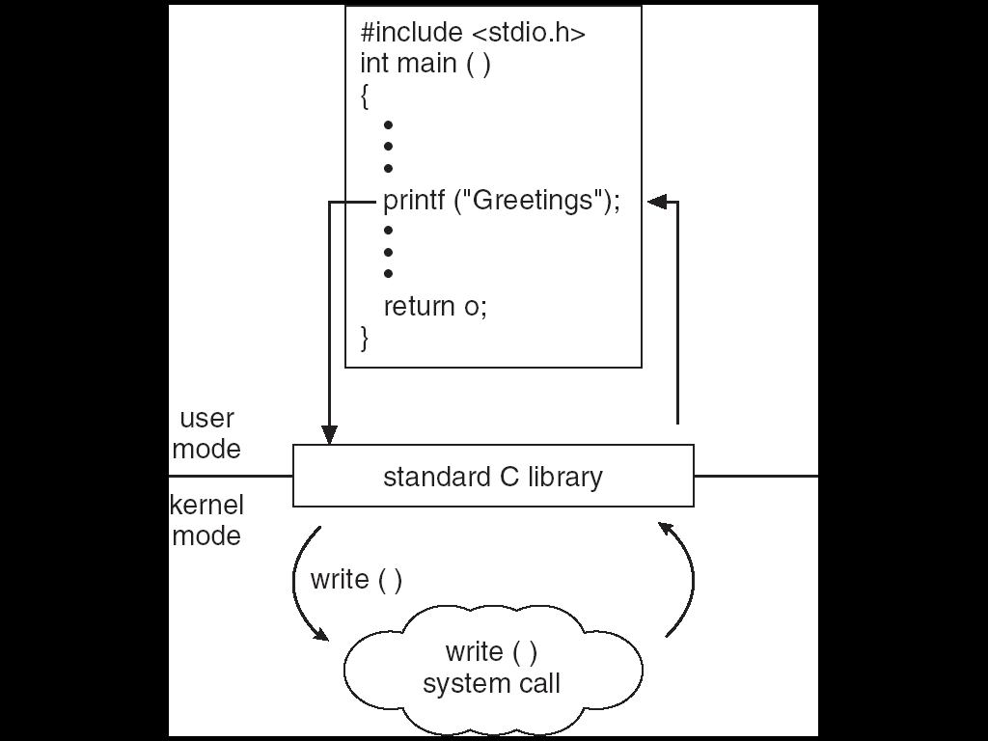
Standard C Library Example
C program invoking printf() library call, which calls write() system call

Slide 15
System Call Parameter Passing
Often, more information is required than simply identity of desired system call
  Exact type and amount of information vary according to OS and call
Three general methods used to pass parameters to the OS
  Simplest: pass the parameters in registers
    In some cases, there may be more parameters than registers
  Parameters stored in a block, or table, in memory, and address of block passed as a parameter in a register
    This approach taken by Linux and Solaris
  Parameters placed, or pushed, onto the stack by the program and popped off the stack by the operating system
  Block and stack methods do not limit the number or length of parameters being passed

Slide 16

Parameter Passing via Table

Slide 17
Types of System Calls
Process control
File management
Device management
Information maintenance
Communications
Etc.

Slide 18
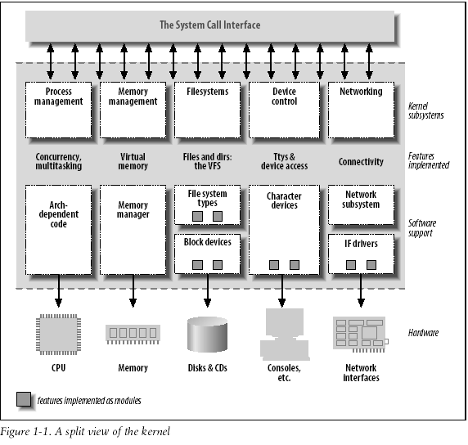
System Calls in a Linux Kernel
Each system call has a corresponding wrapper routine, which defines the Application Program Interface (API). An API does not necessarily correspond to a specific system call.
Wrapper Routines: The system call interface provided by some API, defined by the libc, standard C library, refer to a routine, whose purpose is to issue a system call, handling In/Out parameters.

Slide 19
Benefits of System calls
Modularity
Direct jump to needed facility
Common Interface among different devices
Portability (same calls for different OS implementations)

Slide 20

MS-DOS execution
(a) At system startup (b) running a program

Slide 21

FreeBSD Running Multiple Programs

Slide 22
System Programs
System programs provide a convenient environment for program development execution and system usage. The can be divided into:
  File manipulation
  Status information
  File modification
  Programming language support
  Program loading and execution
  Communications
  Application programs
Most users’ view of the operation system is defined by system programs, not the actual system calls

Slide 23
System Programs
Provide a convenient environment for program development and execution
  Some of them are simply user interfaces to system calls; others are considerably more complex
File management - Create, delete, copy, rename, print, dump, list, and generally manipulate files and directories
Status information
  Some ask the system for info - date, time, amount of available memory, disk space, number of users
  Others provide detailed performance, logging, and debugging information
  Typically, these programs format and print the output to the terminal or other output devices
  Some systems implement a registry - used to store and retrieve configuration information

Slide 24
System Programs (cont’d)
File modification
  Text editors to create and modify files
  Special commands to search contents of files or perform transformations of the text
Programming-language support - Compilers, assemblers, debuggers and interpreters are sometimes provided
Program loading and execution- Absolute loaders, re-locatable loaders, linkage editors, and overlay-loaders, debugging systems for higher-level and machine language
Communications - Provide the mechanism for creating virtual connections among processes, users, and computer systems
  Allow users to send messages to one another’s screens, browse web pages, send electronic-mail messages, log in remotely, transfer files from one machine to another

Slide 25
Operating System Design and Implementation
Design and Implementation of OS not easily “solvable”, but some approaches have proven successful
Internal structure of different Operating Systems can vary widely
Start by defining goals and specifications
Affected by choice of hardware, type of system
User goals and System goals
  User goals – operating system should be convenient to use, easy to learn, reliable, safe, and fast
  System goals – operating system should be easy to design, implement, and maintain, as well as flexible, reliable, error-free, and efficient

Slide 26
Operating System Design and Implementation (Cont.)
Important principle to separate
Policy: What is be done?
Mechanism: How is to be done?
Mechanisms determine how to do something, policies decide what will be done
  The separation of policy from mechanism is a very important principle, it allows maximum flexibility if policy decisions are to be changed later

Slide 27
Simple Structure
MS-DOS – written to provide the most functionality in the least space. Single user, single tasking Operating System
  Not divided into modules
  Although MS-DOS has some structure, its interfaces and levels of functionality are not well separated
  Non-resident part to reduce size of kernel.

Slide 28

MS-DOS Layer Structure

Slide 29
Layered Approach
The operating system is divided into a number of layers (levels), each built on top of lower layers. The bottom layer (layer 0), is the hardware; the highest (layer N) is the user interface.
With modularity, layers are selected such that each uses functions (operations) and services of only lower-level layers

Slide 30

Layered Operating System
Application Processes

Slide 31
Layers
High level and logical facilities are provided in outer layers.
Low level and device specific facilities are concentrated near innermost layers.
System calls and Traps are used to enter from outer layers to inner layers.
Interrupts and return from calls to move from inner layers to outer Layers.

Slide 32
UNIX
UNIX – limited by hardware functionality, the original UNIX operating system had limited structuring. The UNIX OS consists of two separable parts
  Systems programs
  Kernel
The kernel
  Provides the file system, CPU scheduling, memory management, and other operating-system functions; a large number of functions for one level
  Consists of everything below the system-call interface and above the physical hardware

Slide 33

UNIX System Structure

Slide 34
Microkernel System Structure
Moves as much from the kernel into “user” space as possible.
Communication takes place between user modules using message passing
Benefits:
  Easier to extend a microkernel
  Easier to port the operating system to new architectures
  More reliable (less code is running in kernel mode)
  More secure
Detriments:
  Performance overhead of user space to kernel space communication

Slide 35

Mac OS X Structure

Slide 36
Modules
Most modern operating systems implement kernel modules
  Uses object-oriented approach
  Each core component is separate
  Each talks to the others over known interfaces
  Each is loadable as needed within the kernel
Overall, similar to layers but with more flexible

Slide 37

Solaris Modular Approach

Slide 38
Virtual Machines
A Virtual Machine (VM) is defined by Popek and Goldberg (in their paper "Formal requirements for virtualizable third generation architectures," as an "efficient, isolated duplicate of a real machine"
A virtual machine takes the layered approach to its logical conclusion. It treats hardware and the operating system kernel as though they were all hardware
The VM runs in user mode, over a Virtual Machine Monitor VMM, which can support multiple VMs
A virtual machine provides an interface identical to the underlying bare hardware
The operating system creates the illusion of multiple processes, each executing on its own virtual processor similarly each virtual machine works on its own virtual hardware, provided by VMM.

Slide 39
Virtual Machine Monitor
The Virtual Machine Monitor, VMM, runs on top of the hardware in privileged mode, and the VMs run in user mode.
One VMM can support multiple VMs handling different applications or OS environments.
A VMM runs as a privileged application on an existing host operating system.
The VMM can take advantage of the host OS for memory management, processor scheduling, hardware drivers, and resource management.

Slide 40
Virtual Machines (Cont.)
The resources of computer are shared to create the virtual machines
CPU scheduling can create the feel that users have their own processor
Popek and Goldberg's rules of virtualization state that a virtualizable processor architecture allows any instruction that inspects or modifies machine state to be trapped when executed in any but the most privileged mode.
When the VM issues non-privileged instructions to the processor, the VMM passes them to be executed directly. Privileged instructions issued by processes running in user mode cause a trap. This provides the basis for the isolation of a VM from the rest of the machine.
A primary job of a VMM is to trap and handle all machine-specific sensitive instructions (e.g. I/O, Reg access). Sensitive/privileged instructions are issued from the VM, they are trapped and passed to the VMM for handling.
When a trap occurs, rather than generating an exception and crashing, the instruction is sent to the VMM. This allows the VMM to take complete control of the host machine. The VMM then either executes the instruction on the processor, or emulates the results and returns them to the VM or application.

Slide 41

Virtual Machines (Cont.)
(a) Nonvirtual machine (b) virtual machine
Non-virtual Machine
Virtual Machine

Slide 42
Virtual Machines (Cont.)
The virtual-machine concept provides complete protection of system resources since each virtual machine is isolated from all other virtual machines. This isolation, however, permits no direct sharing of resources.
A virtual-machine system is a perfect vehicle for operating-systems research and development. System development is done on the virtual machine, instead of on a physical machine and so does not disrupt normal system operation.
The virtual machine concept is difficult to implement due to the effort required to provide an exact duplicate to the underlying machine

Slide 43
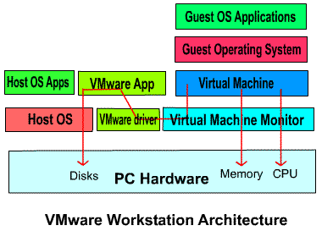
VMware Architecture
  The VM behaves like a raw machine in which an operating system and applications can be installed.
  VMM communicates directly to hardware and through a driver to host Operating System.
  Purely computational operations, will execute directly through the VMM on CPU. For shared resources or I/O operations it uses the host OS for resource utilization on behalf of a virtual machine.

Slide 44

VMware Architecture

Slide 45

The Java Virtual Machine

Slide 46
Operating System Generation
Operating systems are designed to run on any of a class of machines; the system must be configured for each specific computer site
SYSGEN program obtains information concerning the specific configuration of the hardware system and computing requirements and then generates executable kernel.
Booting – starting a computer by loading the kernel
Bootstrap program – code stored in ROM that is able to locate the kernel, load it into memory, and start its execution

Slide 47
System Boot
Upon Power up, a personal computer's CPU runs the instruction located at the memory location CS:IP F000:FFF0 (or linear address 0xFFFF0) of the BIOS. This memory location is close to the end of the of system memory accessible in real mode. It typically contains a jump instruction that transfers execution to the location of the BIOS start-up program. This program runs a power-on self-test (POST) to check and initialize required devices
  Firmware is used to hold initial boot code
Operating system must be made available to hardware so that hardware can start
  Small piece of code – bootstrap loader, locates the boot sector from a bootable device , loads it into memory to linear address 0x7C00 , and starts it
  The boot sector is often operating-system-specific; however, in most operating systems its main function is to load and execute the operating system kernel,

